Slide 1
LHO TCS commissioning update
LVC meeting
March 2019
Danny Vander-Hyde on behalf of the LHO TCS team (Thomas Vo, Dan Brown, Georgia Mansell, Aidan Brooks, Jenne Driggers, Stefan Ballmer, Hang Yu and TJ Shaffer)

Slide 2
TCS schema
Have a crappy hand drawn figure.. do we have an official figure that includes all TCS actuators / Hartmanns or should I draw one up?
Notes:
The primary role of the currently existing thermal compensation system (TCS) is to probe (via Hartmann wavefront sensors (HWS)) and compensate for (via CO2 lasers and ring heaters) thermo-optic distortions of low spatial frequency that can have potentially adverse affects on mirror geometry which in turn affect interferometer contrast, cavity mode mismatch, reduced cavity buildups, etc. especially when operating at high power.
The primary probing is done with Hartmann wavefront sensors placed at each test mass of the dual recycled Fabry-Perot Michelson interferometer and in preparation for O3 we discovered other useful metrics while making final adjustments to TCS actuators.
Actuation by negative lensing is performed by a series of installed ring heaters on each of the test masses that form the Fabry Perot cavities while actuation by positive lensing is induced by firing a CO2 laser onto a compensation plate immediately prior to the carrier entering the arm cavity.
Relevant measurements and techniques that directly apply to the optimal operation of TCS at the aLIGO Hanford observatory for O3 are detailed. Also discussed are the measurements and effects of point absorbers on input/end test masses.
As suggested by models discussed, some of the modeled affects are: higher order mode mismatch from the power recycling cavity to the Y-arm cavity, reduced buildup of RF sidebands in the recycling cavities, and light scatter into higher order modes in the LIGO arm cavities.
Keeping the interferometer locked above 30 W input power with the presence of these absorbers is a challenge and may fundamentally limit LHO from achieving a stable configuration at 50 Watts with the currently existing TCS.

Slide 3
Initial TCS pre-O3 gameplan
Ran into a few problems along the way
Improve Michelson contrast defect
Increasing power to DRFPMI
Self heating measurements of TMs when increasing power
Estimate absorption coefficients
Maintaining lock
Set RHs to compensate for self heating going up to 50 W
Adjust CO2s to replicate ifo self heating at 50 W
Mode Matching IFO to OMC
OMC scans with different DARM offsets
Turn on SRM and/or SR3 heating
Point absorbers on ITMY and ETMX
LSC and ASC error signals deteriorate with
particular TCS settings
Alignment constraints for SRM heater?
FINE TUNING TCS IS A SLOW PROCESS
Notes:
Acquire good contrast when cold
Maintain those good lenses when the interferometer is hot

Slide 4
Brief overview of HWS output
CO2 increase (Central heating)
Update with HWS live figure
Spherical power trend data
RH increase (annular heating)
Notes:
CO2

Slide 5
Contrast Defect
Before improving contrast w/ TCS we aligned CO2s
Dither alignment system in single bounce
Reduce the amount of misalignment modes you see in the dark fringe
Improve Michelson contrast defect using CO2s
Quickest way to find best differential lens solution
Use HWS trend data to inform what static TCS settings you want to implement
Notes:
Discuss briefly

Slide 6
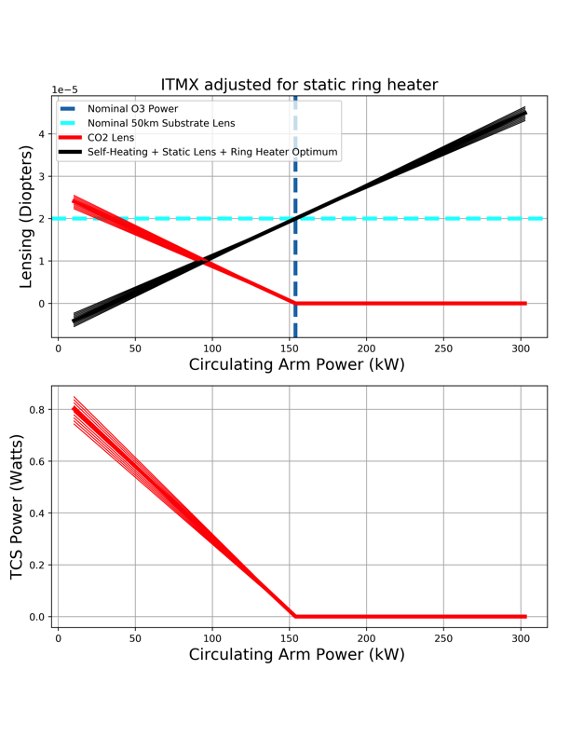
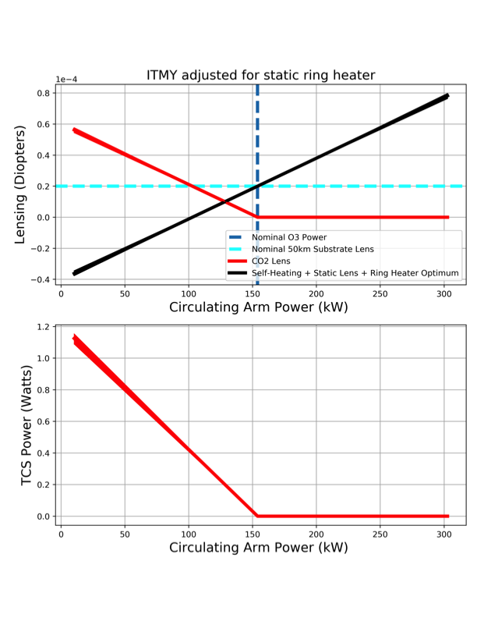
Increasing power
PC: Thomas Vo
Notes:
The philosophy here is to use the ring heaters to create a static negative lens that will compensate for the self heating and use the CO2 to replicate the lensing from the self heating in a “cold” state.
Helps maintain realistic hot conditions when locking the interferometer

Slide 7
Increasing power (Self heating and absorption measurements)
ITMX | ETMX | ITMY* | ETMY
344 ppb | 400 ppb | 804 ppb | 400 ppb
Put some of TVo’s fits using MC-MC here.
Should analyze more data to update?
* Majority of the uniform lens we believe we see is from the uniform lens induced by the point absorber

Slide 8
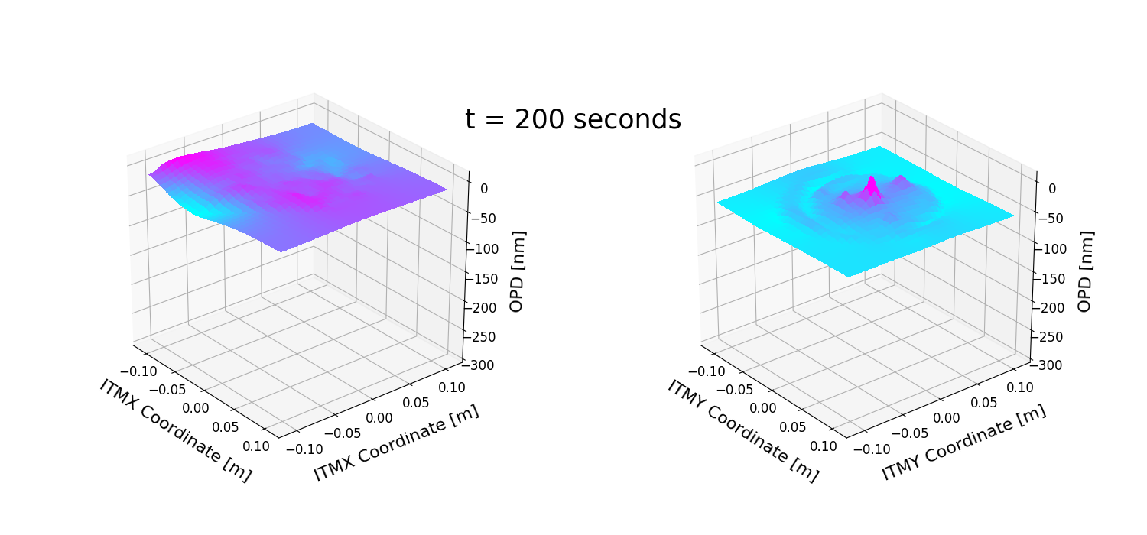
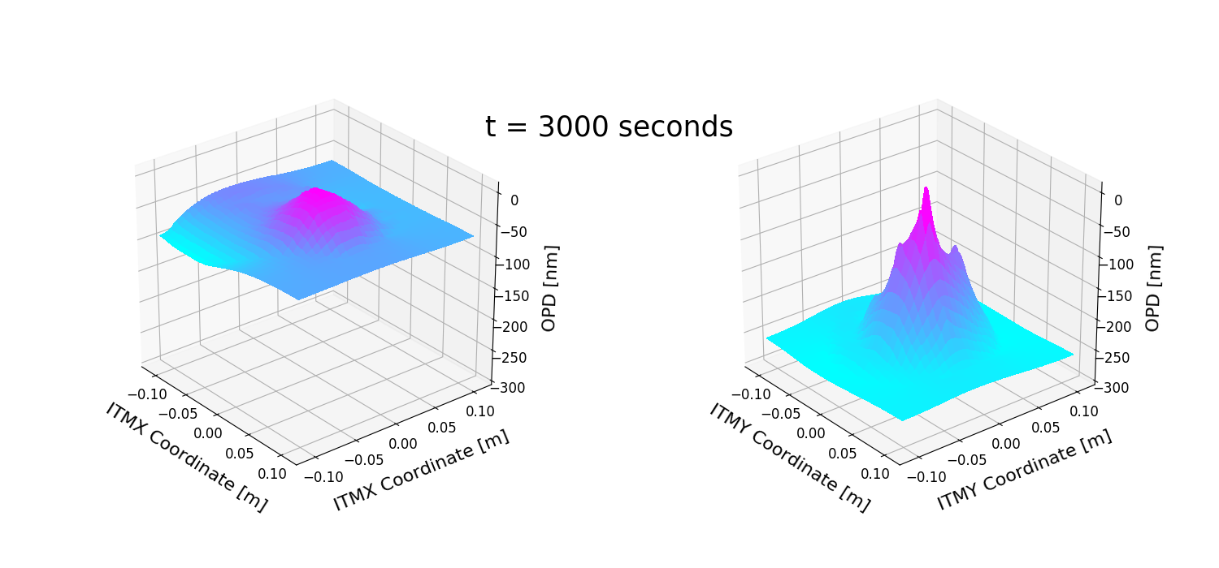
ITMY Point absorbers
PC: Thomas Vo
Notes:
After a couple of weeks of attempting to tune differential lensing at 10W, we discovered that there were 3-5 point absorbers on ITMY
Talk about the peak optical path distortion introduced by each of the absorbers and a more proper characterization is in the works.

Slide 9
ETMX point absorber
Notes:
* Brief characterization of this guy in terms of peak optical path distortion? (relative to uniform surface lens?)

Slide 10
Moving spot positions (ITMY point absorbers)
Before
After
Notes:
Hiro mentioned the effects of the ETM point absorber
max scattering into the (n+m) = 7 mode can occur when the absorber is shifted 2cm away from the ifo beam center?
After seeing the success Livingston had of improving optical gain from moving around the spot position away from their ETM point absorber.
We wanted to shift to simultaneously move away from the ETM point absorber while finding a more favorable position (Better PRG, reduced OPD measured)
Cosmetically this looks worse and more un-uniform but circulating arm power was improved and the maximum optical path distortion was reduced
Moved the beam x cm horizontally and 1.7 cm vertically on ITMY

Slide 11
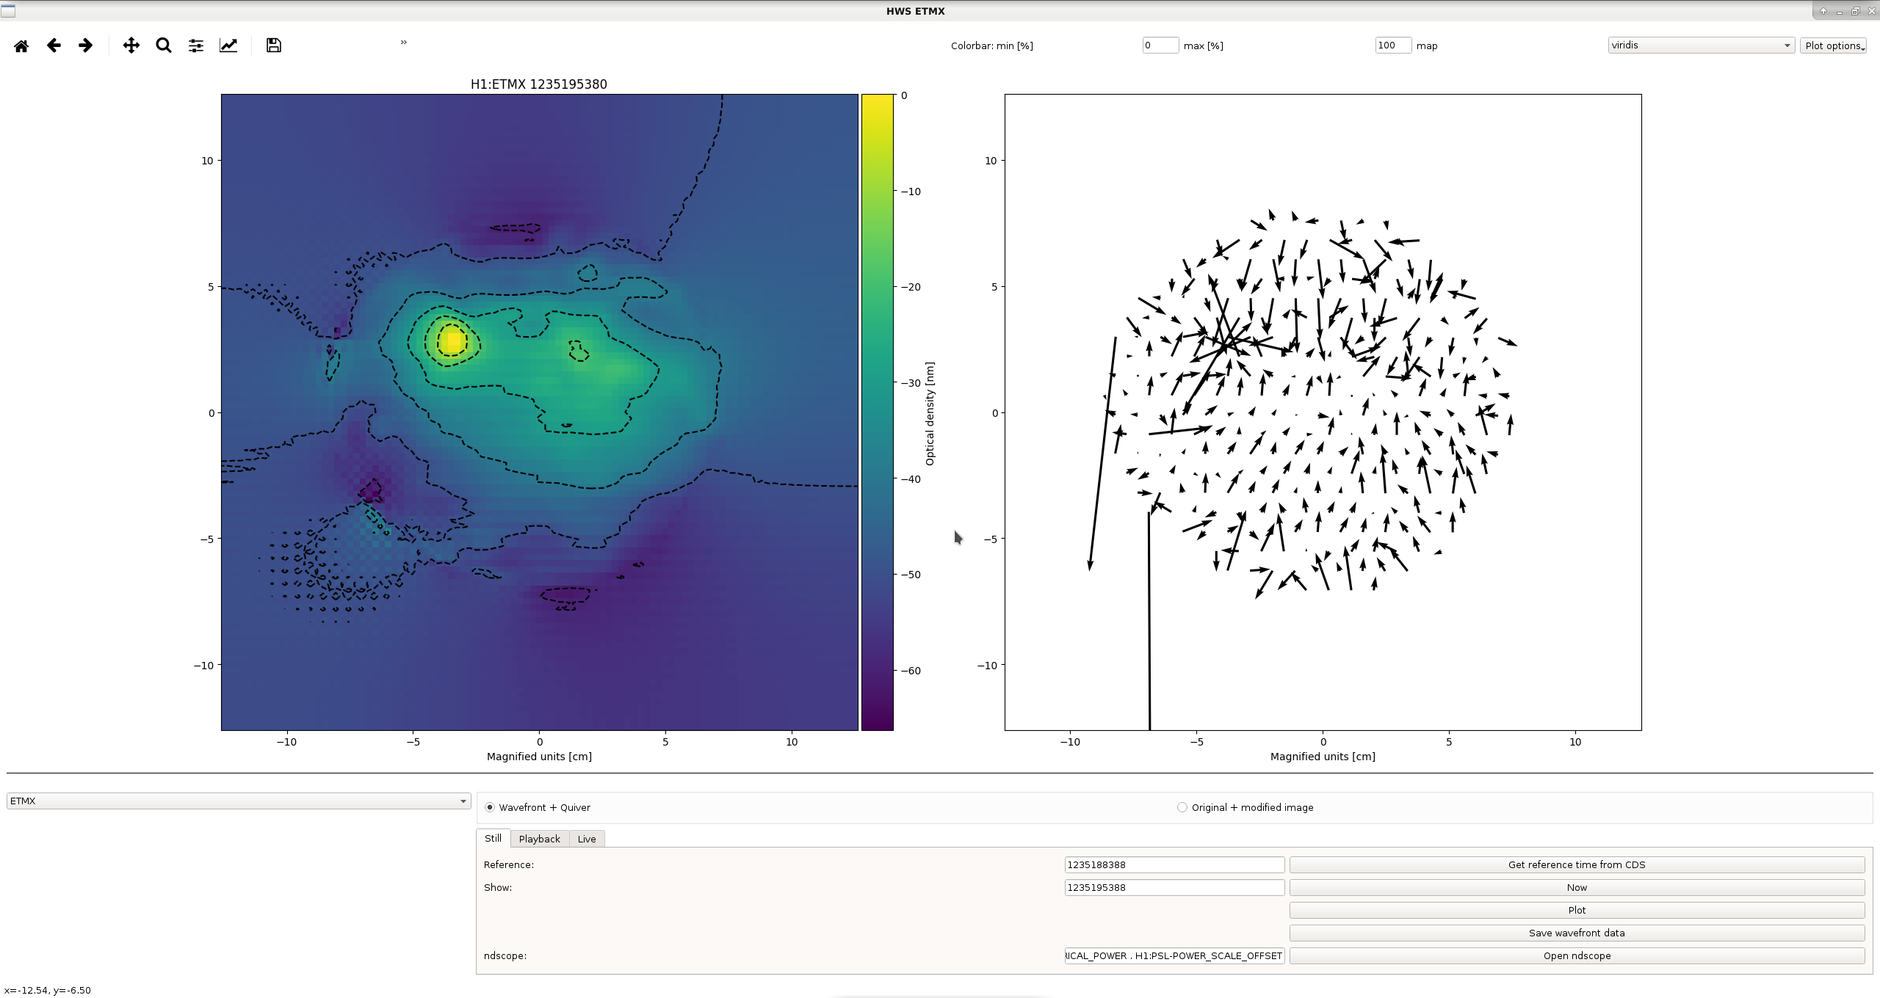
Moving spot positions (ETMX point absorber)
Before
After
Notes:
Changed the A2L gains so that we could move x cm horizontally away and x cm vertically on ETMX

Slide 12
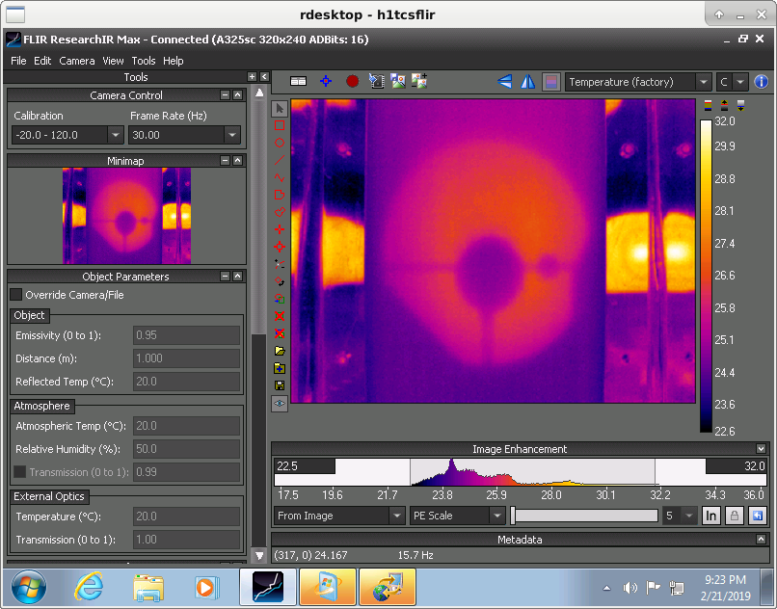
CO2Y mask
PC: Aidan Brooks
SHOUT OUT TO AIDAN’S TALK ON THE POINT ABSORBERS FOR MORE INFO
Notes:
Should reduce the asymmetrical lens induced by the point absorbers
First tests with only CO2 reduced the amount of 9MHz RIN coupling to DARM by %
Statements about frequency/intensity noise?

Slide 13
Fine tuning TCS
Working in a complicated parameter space:
Presence of point absorbers
Coupling of TCS to LSC and ASC signals
Finesse ifo model with error signals (D. Brown)
Adjusting differential and common lensing
Aim: improve arm power buildup, improve RF 9 and 45 buildup.
Some pictures / logs of Dan and Hang’s Christmas break journey

Slide 14
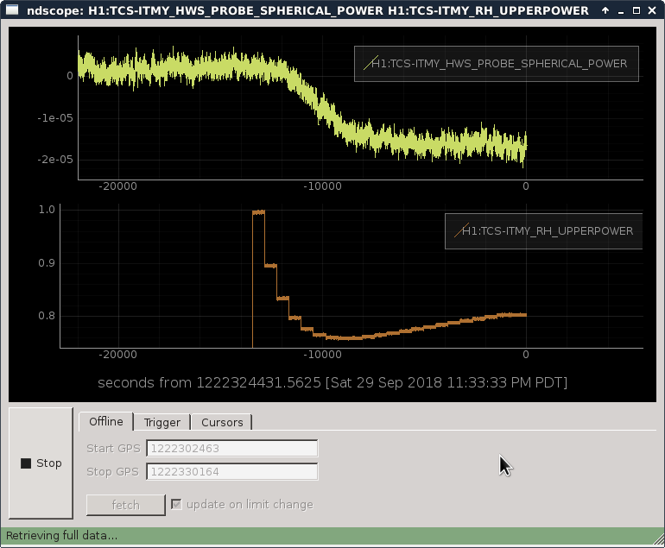
Fine Tuning TCS (cont.)
New TCS tools:
HWS live
Viewing Hartmann phase maps has never been easier
Conditioning RH input power
Reduces the lens convergence time from 10 hours to 2.5-3 hours

Slide 15
Estimated nominal lenses (cold to overall lensing with TCS (no self heating))

Slide 16
Mode matching to OMC (SR3 heating)
Initial tests: Did not measure anything significant possibly because of the short time scale of test and the tests were performed early in the lock.
Overnight test: Increased optical gain, better DRMI?

Slide 17
Future
Modelling TCS to ASC coupling
Reducing frequency and Intensity noise
SRM heater
Analyzing mode content at AS port amongst other places:
Mode converter for measuring first order mode mismatch on QPDs
Phase cameras

Slide 18
References

Slide 19
Special Thanks
Thomas Vo, Dan Brown, Hang Yu, Aidan Brooks, Stefan Ballmer, Jenne Driggers, Sheila Dwyer, Daniel Sigg, Rick Savage, and everyone else at LHO.
LSC fellows program

